Slide 1
Cascading Style Sheets Presentation 3

Slide 2
CSS Text Formatting

Slide 3
CSS Text Color
Font color specified by color property
Two primary ways of specifying colors:
Color name: black, gray, silver, white, red, lime, blue, yellow, aqua, fuchsia, maroon, green, navy, olive, teal, purple, full list at http://www.w3.org/TR/SVG11/types.html#ColorKeywords
red/green/blue (RGB) values

Slide 4
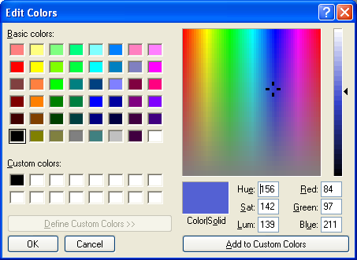
CSS Text Color

Slide 5
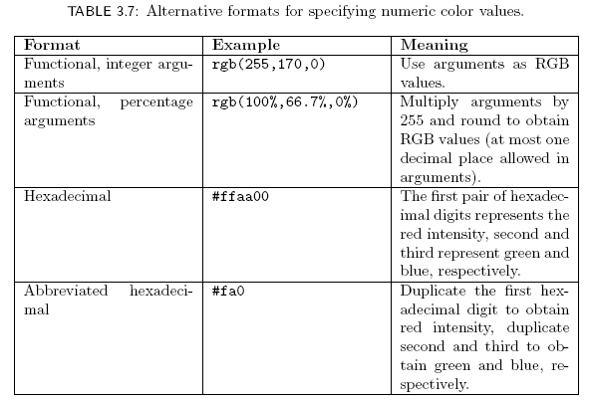
CSS Text Color

Slide 6
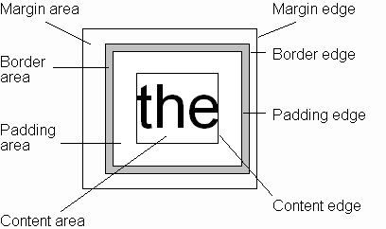
CSS Box Model
Every rendered element occupies a box:
(or outer edge)

Slide 7
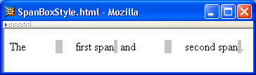
CSS Box Model

Slide 8
CSS Box Model

Slide 9
CSS Box Model

Slide 10
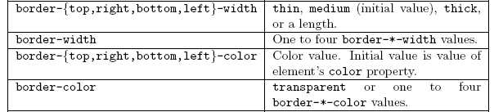
CSS Box Model

Slide 11
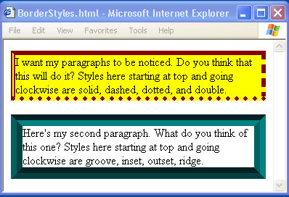
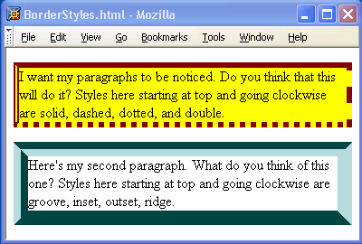
CSS Box Model

Slide 12
CSS Box Model

Slide 13
CSS Box Model
If multiple declarations apply to a property, the last declaration overrides earlier specifications
Left border is 30px wide,
inset style, and red

Slide 14
Backgrounds
background-color
Specifies background color for content, padding, and border areas
Margin area is always transparent
Not inherited; initial value transparent
background-image
Specifies (using url() function) image that will be tiled over an element

Slide 15
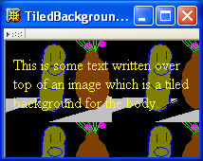
Backgrounds
<body style="background-image:url('CucumberFlowerPot.png')">

Slide 16
Normal Flow Layout
In normal flow processing, each displayed element has a corresponding box
html element box is called initial containing block and corresponds to entire document
Boxes of child elements are contained in boxes of parent
Sibling block elements are laid out one on top of the other
Sibling inline elements are one after the other

Slide 17
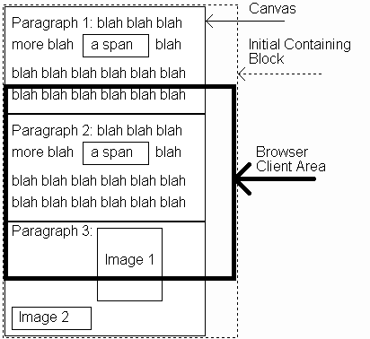
Normal Flow Layout
(body)
(html)

Slide 18
Normal Flow Layout
Block
elements
only

Slide 19
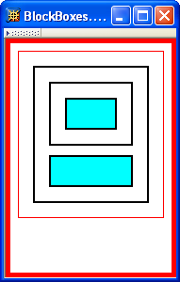
Normal Flow Layout
html
body
div d1
div d2
div d3
div d4
Top edges of
block boxes are
in document order

Slide 20
Normal Flow Layout
What is a “block element”?
Element with value block specified for its display property
User agent style sheet (not CSS) specifies default values; typical block elements include html, body, p, pre, div, form, ol, ul, dl, hr, h1 through h6
Most other elements except li and table-related have inline specified for display

Slide 21
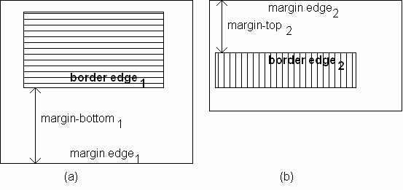
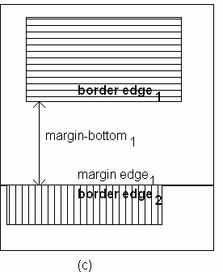
Normal Flow Layout
When blocks stack, adjacent margins are collapsed to the size of the larger margin

Slide 22
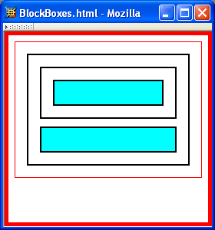
Normal Flow Layout
Initial value of width property is auto, which for block boxes means to make the content area as wide as possible within margin/padding constraints:
Width of block boxes
increases as browser
client area is widened

Slide 23
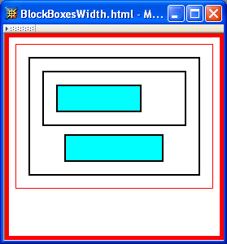
Normal Flow Layout
Can also specify CSS length or percentage (of parent’s content width) for width property
By default, width of right margin is adjusted to accommodate a change to width

Slide 24
Normal Flow Layout
Can also specify CSS length or percentage (of parent’s content width) for width property
Centering can be achieved by setting
both margins to auto

Slide 25
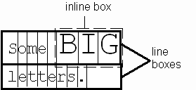
Normal Flow Layout
Boxes corresponding to character cells and inline elements are laid out side by side in line boxes that are stacked one on top of the other
Heights based on
content
Character cells aligned by baseline

Slide 26
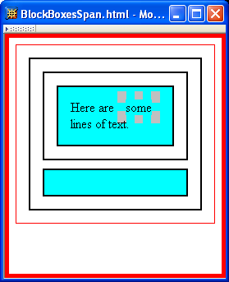
Normal Flow Layout
Padding/borders/margins affect width but not height of inline boxes

Slide 27
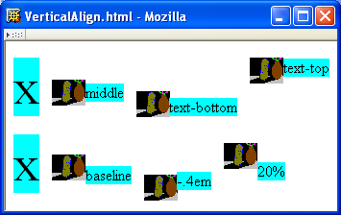
Normal Flow Layout
Specify value for vertical-align to position an inline element within line box:
initial value of vertical-align

Slide 28
That’s All For today !!!

